Slide 1
Tutorial 2
Statistical Computation and Analysis
Spring 2025

Slide 2
Tutorial Outline
Data
Experiments
Summary statistics
Central tendency
Spread
Skewness
Kurtosis
Probabilities and random variables
Distributions
Conditional probabilities
Bayes theorem

Slide 3
Data
A set of observations or measurements
Finite
We can get more data, but it will still be data
Types of data:
Continuous – there can be another data point between any two data values.
Categorical – values can’t be put on a scale.
Ordinal – data can be ordered but are not real numbers.

Slide 4
Data
Morning/afternoon/evening
Weight
Heights
Gender
Time
Color
Baby/child/teenager
Continuous
Ordinal
Categorical
Notes:
If in color we are really looking at wavelength -> continuous.
If we are looking at the order of the rainbow - ordinal

Slide 5
Data
We need to understand what we are measuring
What is the precision?
How much precision do we need to draw conclusions?
Elephant age by weight in kg
Can we use this precision for measuring amounts of medicine?
Is the data valid?
Does the data measure what you want?
Is musical ability indicative of who will be a good doctor?
Is a psychometric grade indicative of who would be a good doctor?
Is the data reliable?
A measure that is stable – the value will stay the same:
If we measure again
If someone else measures
If we measure at different times (if the measurement is not meant to change over time)
Notes:
What we are measuring – not always so straight forward. We want to know if the medicine is helping, what measurements should we take?
If the virus appears only in the blood, looking at any other sample is useless. Or what in the blood do we need to look at. What units are we measuring in. can our measurements answer the question we’re asking.

Slide 6
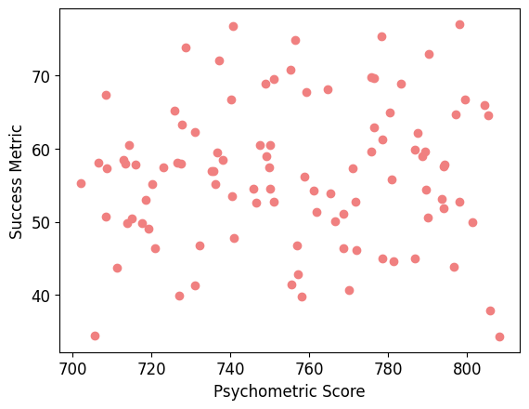
Validity

Slide 7
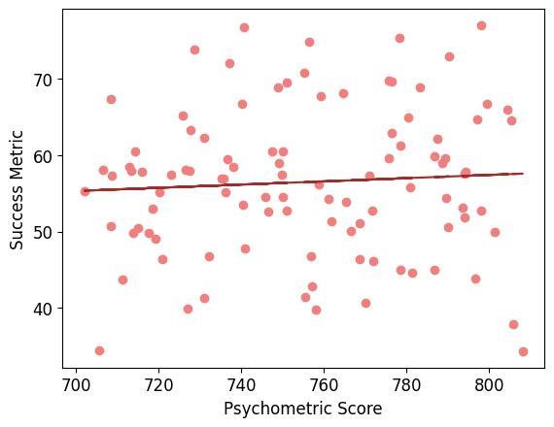
Validity

Slide 8
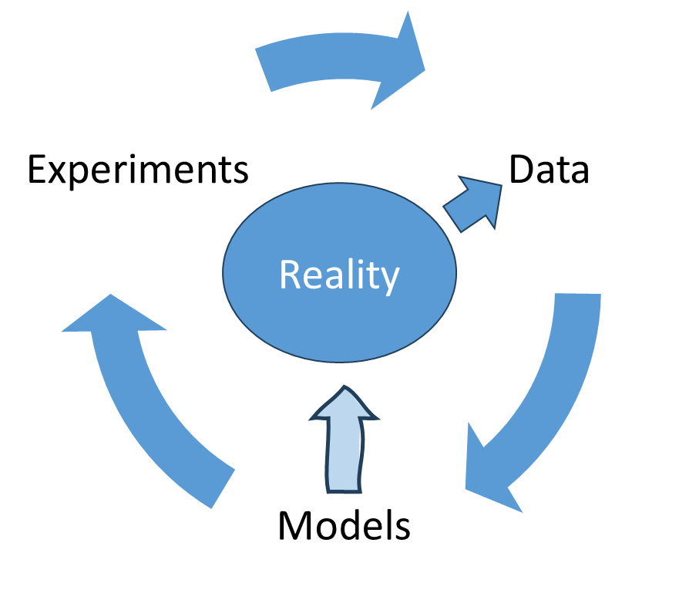
Data
Experiments produce data from reality
Data updates models of reality
Models lead to further experiments
Notes:
You understand that what you measure is what you measure, and what is out there is out there.
Data usually reflects multiple measurements and potentially multiple dimensions - each measurement is a poor (noisy, biased, incomplete) measurement of reality.
Repetitions to understand the underlying

Slide 9
Data
Experiments produce data from reality
Data updates models of reality
Models lead to further experiments
Data is a concept associated with understanding that measurements are not infinitely precise.
Data usually reflects multiple measurements and potentially multiple dimensions - each measurement is a poor measurement of reality.
Notes:
You understand that what you measure is what you measure, and what is out there is out there.
Data usually reflects multiple measurements and potentially multiple dimensions - each measurement is a poor (noisy, biased, incomplete) measurement of reality.
Repetitions to understand the underlying

Slide 10
Experiment
Our experiment will be asking questions:
How many siblings do you have? (discrete)
What is your height? (continuous)
https://docs.google.com/forms/d/e/1FAIpQLSfqCmuVLoOisvyWWSiETPb5XT-fdRqU36iP0RMp3_s4wQOI8Q/viewform?usp=sharing
Notes:
Do a very simple experiment – ask some questions.
This will get us data.
Google sheet - https://docs.google.com/spreadsheets/d/1SzEokz4ThtbLpjW8n38EGD-0N4R_vXD2nvo1GdKqhuQ/edit?resourcekey=&gid=1125693093#gid=1125693093

Slide 11
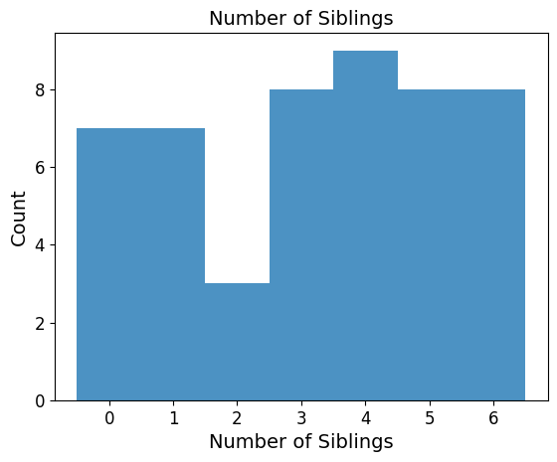
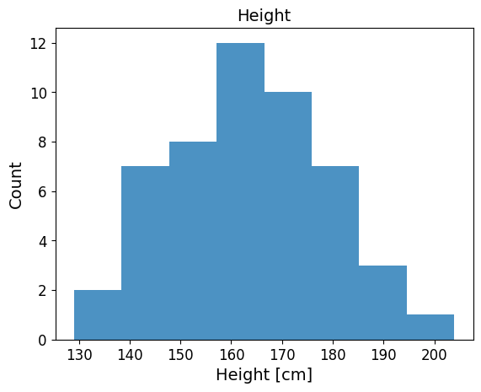
Plotting Results
With random data:

Slide 12
Experiment Conclusions
We can use (simple or complex) experiments to collect data.
If we run the experiment again on different participants, we will get different measurements.
Each measurement is a poor measurement of reality.
At the end of the experiment, we have some measurements of heights or number of siblings.
What do we do with these measurements?

Slide 13
Summary Statistics
We can use metrics to summarize different aspects of our collected data.
Central tendency
Spread
Skewness
Kurtosis

Slide 14
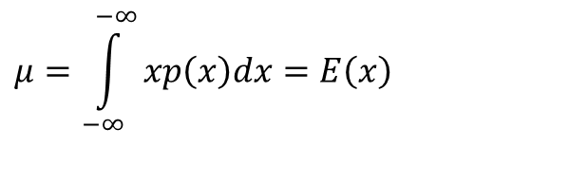

Central Tendency
Measure for middle of the data
Mean:
Median :
Mode – the most frequent value.
$$μ=\int_{−∞}^{−∞}{xp\left(x\right)dx}=E\left(x\right)$$
$$\int_{−∞}^{x_{med}}{p\left(x\right)dx}=0.5$$
Notes:
Mean – care more about big errors than small ones.
Median – care about all sizes of errirs equally,
Mode – want to make as few errors as possible

Slide 15
Central Tendency
Measure for middle of the data
Mean – the sum of all values divided by the total number of values.
Median – the middle number in an ordered dataset.
Mode – the most frequent value.
Notes:
Mean:
Common
Convenient to work with mathematically
Very effected by outliers
Continuous or ordinal (for ordinal need to assign numbers to the categories, e.g., favorite meal, and breakfast, lunch, dinner = 0, 1, 2. The number assignment changes mean. We would have the number of people that preferred each meal)
Median:
The value in the middle -> the same percentage of the population above and below
Continuous or ordinal (no meaning to a median if the data can't be ordered) the median can be that lunch is the preferred meal. Or that size small is.
Mode:
1. The only central tendency measurement for categorical data. Most people prefer dinner. Medicine 1 worked best.

Slide 16
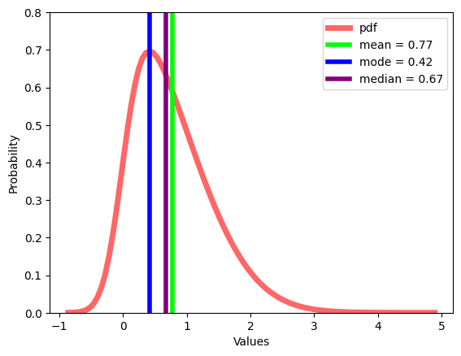
Central Tendency
Where is the middle?
Notes:
Add review of pdf
Add equations for parameters
Population median (sklearn and pds) vs sample median (estimator)

Slide 17
Central Tendency
Measure for middle of the data
Mean
Convenient to work with mathematically
Very effected by outliers
Can be used for continuous or ordinal data (for ordinal, we need to assign numbers to the categories)
Median
Less effected by outliers
Can be used for continuous or ordinal data
Mode
Less effected by outliers
The only central tendency measurement for categorical data
Notes:
Mean:
Common
Convenient to work with mathematically
Very effected by outliers
Continuous or ordinal (for ordinal need to assign numbers to the categories, e.g., favorite meal, and breakfast, lunch, dinner = 0, 1, 2. The number assignment changes mean. We would have the number of people that preferred each meal)
Median:
The value in the middle -> the same percentage of the population above and below
Continuous or ordinal (no meaning to a median if the data can't be ordered) the median can be that lunch is the preferred meal. Or that size small is.
Mode:
1. The only central tendency measurement for categorical data. Most people prefer dinner. Medicine 1 worked best.

Slide 18
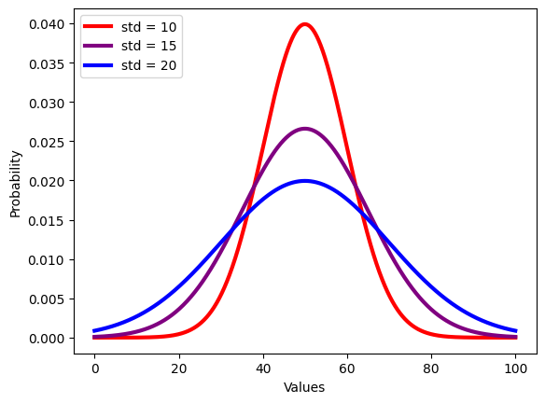

Spread
$$Var\left(x\right)=E\left[{\left(x−μ\right)}^{2}\right]$$
$$std\left(x\right)= \sqrt{Var(x)}$$
How far are we from the middle?
Notes:
If we want to use two numbers

Slide 19
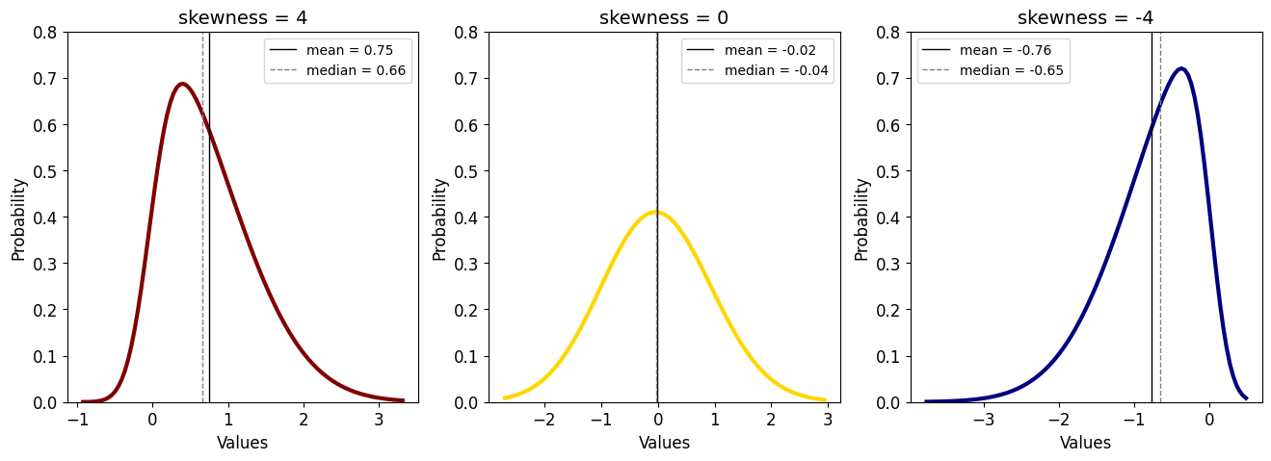
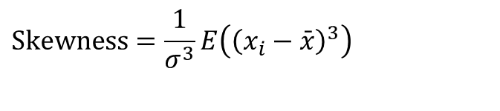

Skewness
$$\text{Skewness}=\frac{1}{σ^{3}}E\left({\left(x_{i}−\bar{x}\right)}^{3}\right)$$
How symmetric is the data?
$$μ$$
Notes:
If we want to use three numbers.
How do we compute on data?
This is what we compute on the population, so it’s a parameter -> change x hat to mu
If I didn’t get to this in the first tutorial -> opher will do it

Slide 20
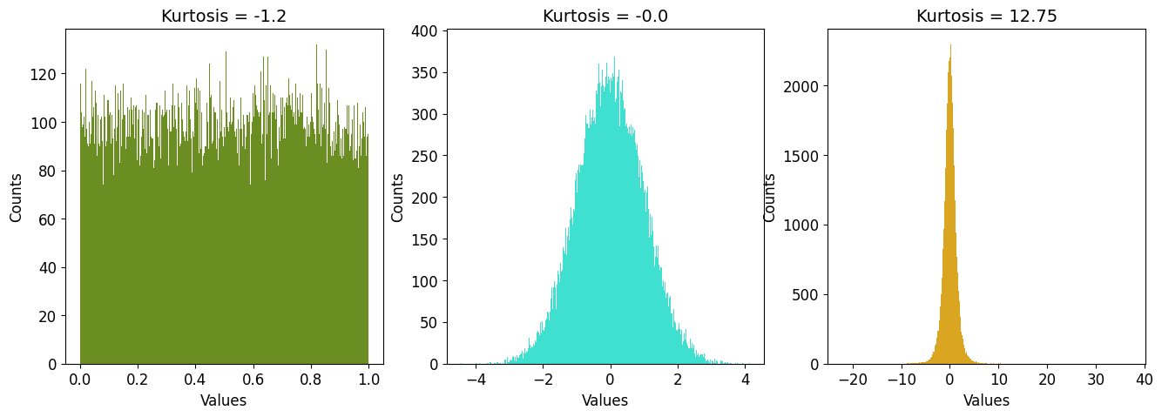
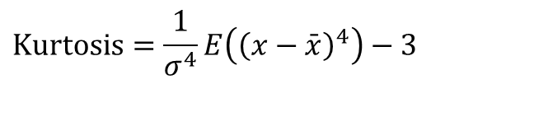

Kurtosis
$$\text{Kurtosis}=\frac{1}{σ^{4}}E\left({\left(x−\bar{x}\right)}^{4}\right)−3$$
Size of tails
Pointiness of peak
$$μ$$
Notes:
If we want to use four numbers.
How do we compute on data?
Can be with our without the three. The minus three sets the kurtosis of a normal distribution to be 0, and then positive is heavier tail than normal distribution, and negative – smaller tails. More of the data is in the middle.
Uniform – more of the data in the middle and not much tail.

Slide 21
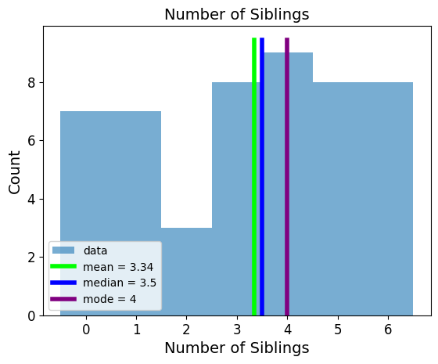
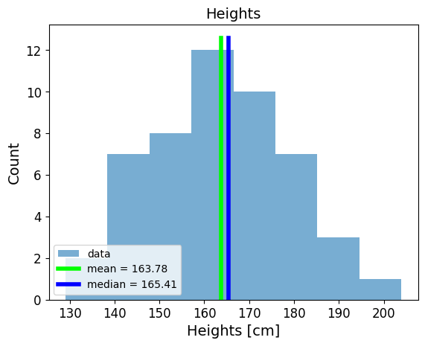
Central Dendency
Why didn’t we calculate the mode for the heights?
With random data:
Notes:
Each exact value appears only once. To actually calculate the mode, we would need to first model the data and then use the mode of the distribution. We did not have this problem with the discrete data because values did repeat themselves.

Slide 22
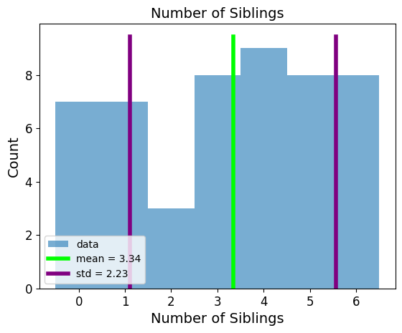
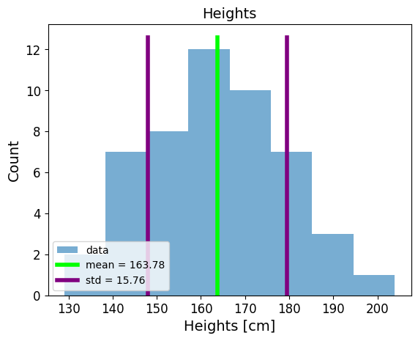
Spread
With random data:
Notes:
If the mean is 10 and the standard deviation is 2, then mean ± 1 std would be 10 ± 2, i.e., [8, 12], which encompasses about 68% of the data for a normal distribution.

Slide 23
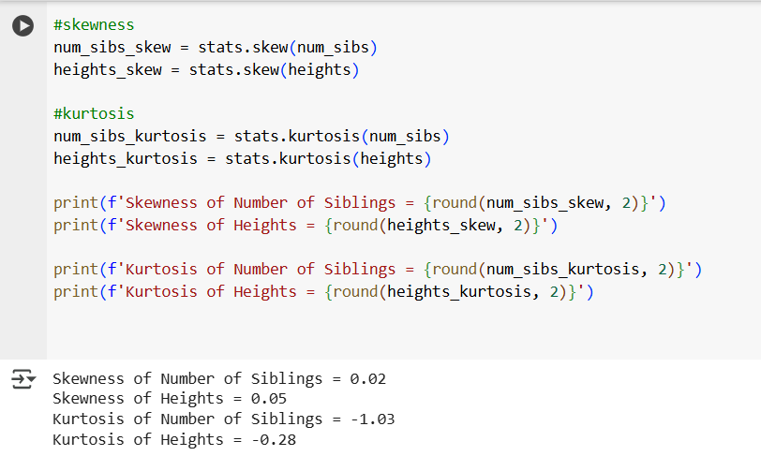
Skewness and Kurtosis

Slide 24
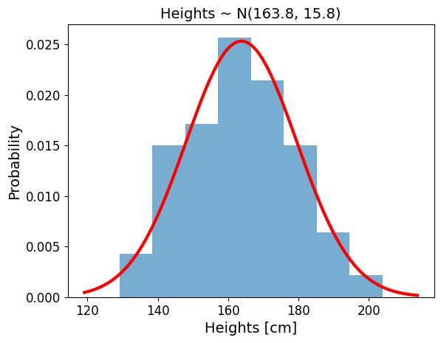
Distribution
We can also model the distribution of the data.
Notes:
We’ll talk about modelling extensively for much of the course. Now we’re just going to do an introduction / review to distributions and probability

Slide 25
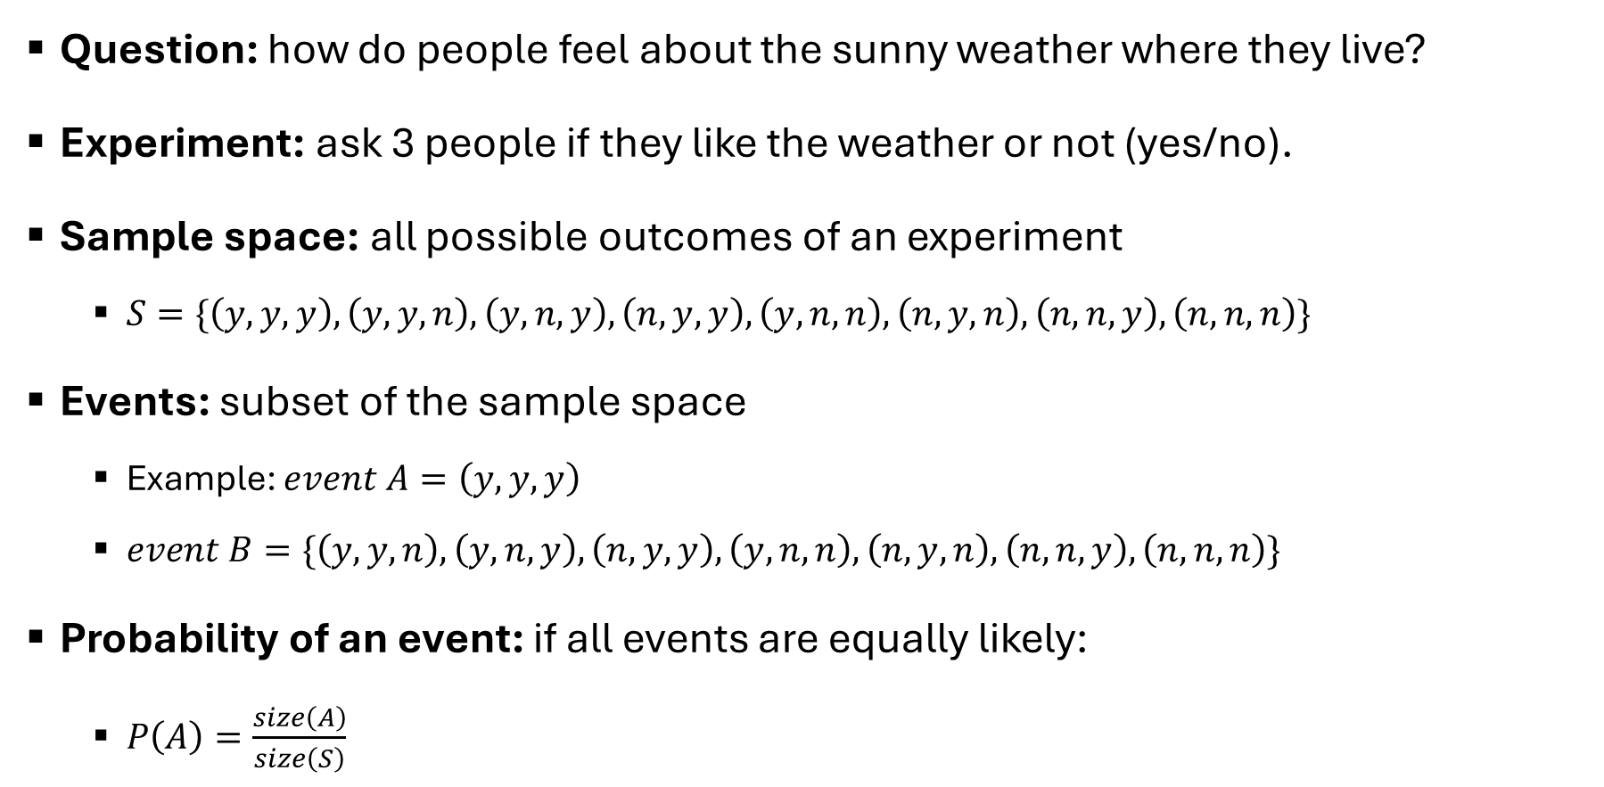
Probability
Question: how do people feel about the sunny weather where they live?
Experiment: ask 3 people if they like the weather or not (yes/no).
Sample space: all possible outcomes of an experiment
$S=\{\left(y,y,y\right), \left(y,y,n\right), \left(y,n,y\right), \left(n,y,y\right), \left(y,n,n\right), \left(n,y,n\right), \left(n,n,y\right), \left(n,n,n\right)\}$
Events: subset of the sample space
Example: $event A=\left(y,y,y\right)$
$event B=\{\left(y,y,n\right), \left(y,n,y\right), \left(n,y,y\right), \left(y,n,n\right), \left(n,y,n\right), \left(n,n,y\right), \left(n,n,n\right)\}$
Probability of an event: if all events are equally likely:
$P\left(A\right)=\frac{size\left(A\right)}{size\left(S\right)}$
Notes:
Event B – at least one person answered no.

Slide 26
Probability
Considering all events equally likely makes calculating probability easier, but it’s not necessarily true.
It is NOT true that all yes-no questions have a 50-50 chance (do you like going to the doctor?)
What is the probability of seeing a purple horse?
Natural color
Cartoon
We’ll assign a distribution.

Slide 27
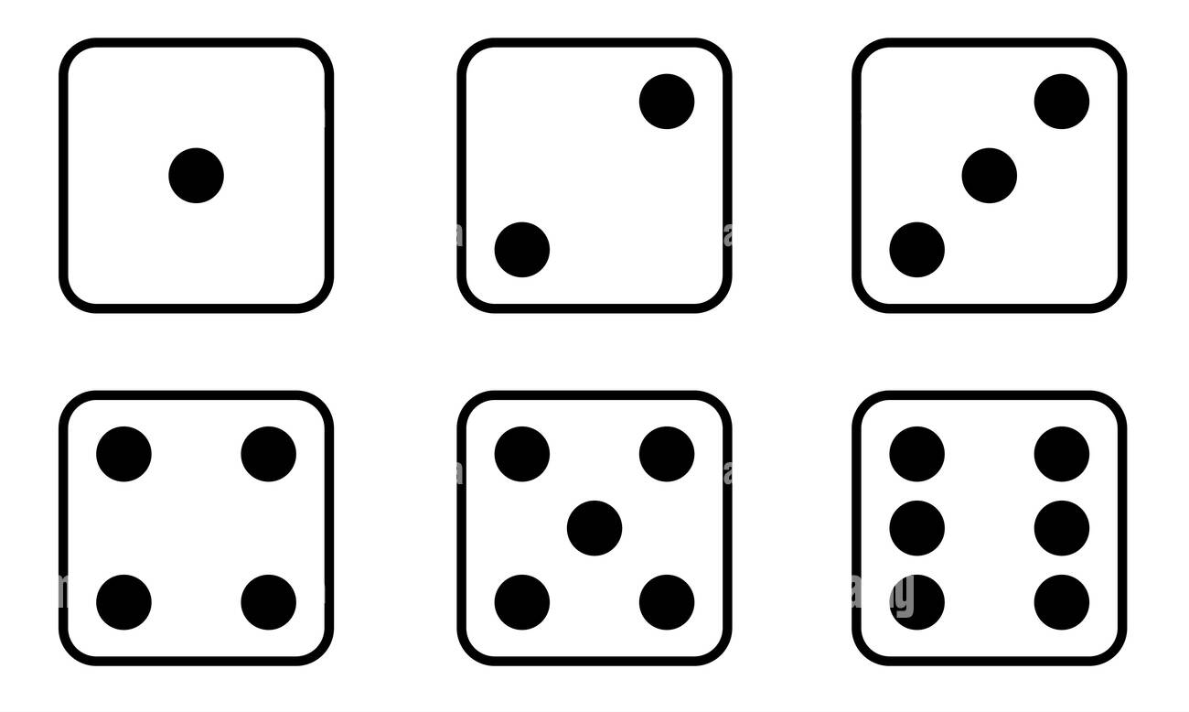

Random Variable
Function that maps the sample space into real numbers (R)
P(X=3), P(X=x), P(x$≤$4)
Discrete / Continuous
Instead of calculating probabilities of events, we may be more interested in finding out the list of probabilities for all possible events = probability distribution.
1
2
3
4
5
6
Notes:
The mapping between the sample space and ℝ is deterministic. There is no randomness
involved. So why do we call it a random variable? Because we can ask the variable for
values, and every time we ask, we will get a different number.

Slide 28
Discrete Random Variables + Distributions
Instead of calculating probabilities of events, we may be more interested in finding out the list of probabilities for all possible events = probability distribution
Empirical probability distribution:
roll a dice a bunch of times
count how many times we get each number
Normalize by dividing the value for each number by the number of times the dice was rolled
We will do this using advanced computational methods
Notes:
For now, lets review all the distributions we know up until this point.

Slide 29
Preliz
We will use this library a lot.
https://github.com/arviz-devs/preliz
Use installation from the tutorial notebook.
Notes:
For now, lets review all the distributions we know up until this point.

Slide 30
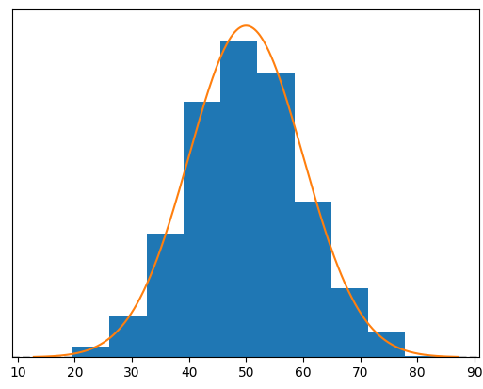

Normal Distribution
$$f\left(x\right)=\frac{1}{\sqrt{2π}σ}e^{−\frac{1}{2}{\left(\frac{x−μ}{σ}\right)}^{2}}$$
$μ$ – mean
$σ$ – standard deviation
f(x) – probability density function
Notes:
The key point is that the value of a probability density function at a specific point x represents a density rather than an actual probability. The PDF does not directly give the probability of x, but rather how "dense" the probability is around x.
The probability of a continuous random variable falling exactly at any specific point is always 0. For continuous distributions, probabilities are defined over intervals.
Because the limits of the integral are the same on the top and the bottom.

Slide 31
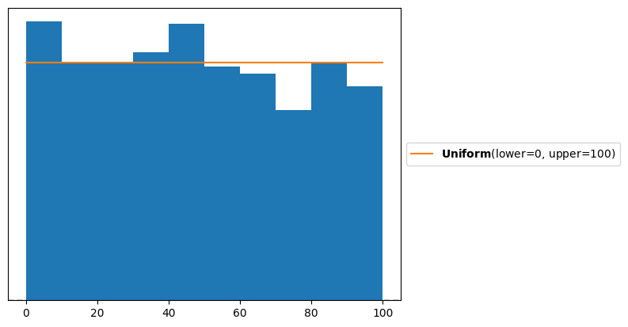

Continuous Uniform
$$f\left(x\right)=\left\{\begin{aligned}\frac{1}{b−a}, a≤x≤b \\ &0, else\end{aligned}\right.$$
f(x) – probability density function
Notes:
There is also a discrete uniform distribution – for example, throwing a dice – all outcomes are equally likely for a fair dice, where the bounds are between 1-6.

Slide 32
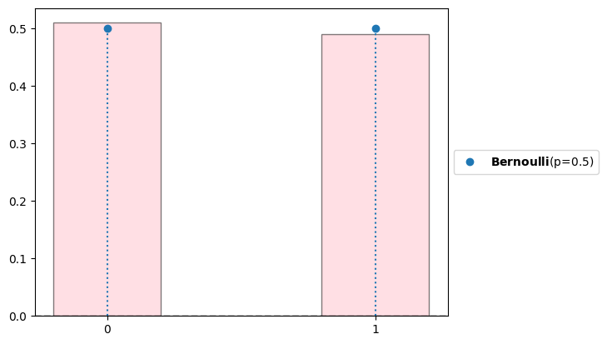
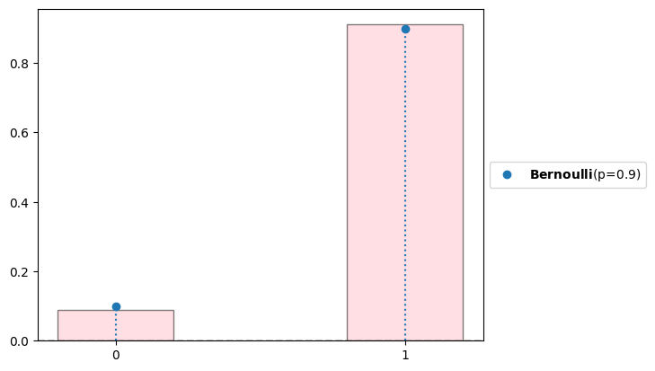

Bernoulli
$$f\left(x\right)=\left\{\begin{aligned}p, x=1 \\ &1−p, x=0\end{aligned}\right.$$
p = the probability of success
1-p = the probability of failure
Coin toss – fair coin p=0.5
sucess / failure in a single trial
f(x) – probability mass function
Notes:
Discrete – the chance for success.
A PDF gives the relative likelihood of the random variable taking a specific value, but it does not give the probability of the random variable being exactly equal to a value.
A PMF gives the probability that a discrete random variable is equal to a particular value.
The bar plot instead of the hist is because with density = true, plt normalizes also by bin width which is irrelevant in a pmf

Slide 33
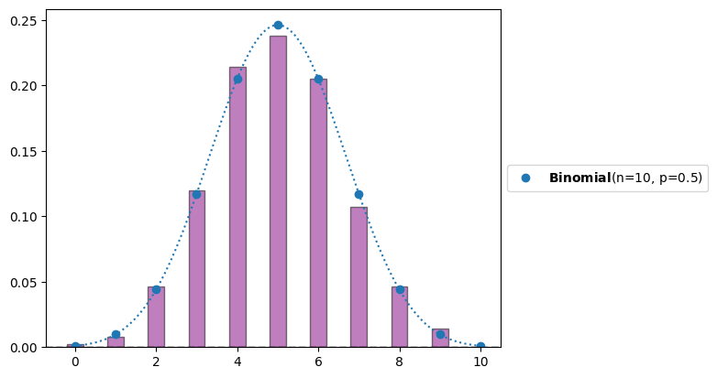
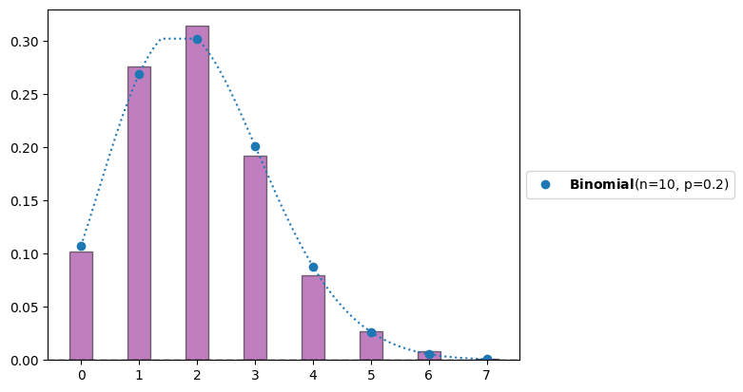

Binomial
$$f\left(k, n, p\right)=\left(\begin{matrix}n \\ k\end{matrix}\right)p^{k}{\left(1−p\right)}^{n−k}$$
p = the probability of success
n = the number of experiments
k = the number of successes
f – probability mass function
Notes:
$$f\left(k, n, p\right)=P\left(X=k\right)=\left(\begin{matrix}n \\ k\end{matrix}\right)p^{k}{\left(1−p\right)}^{n−k}$$

Slide 34
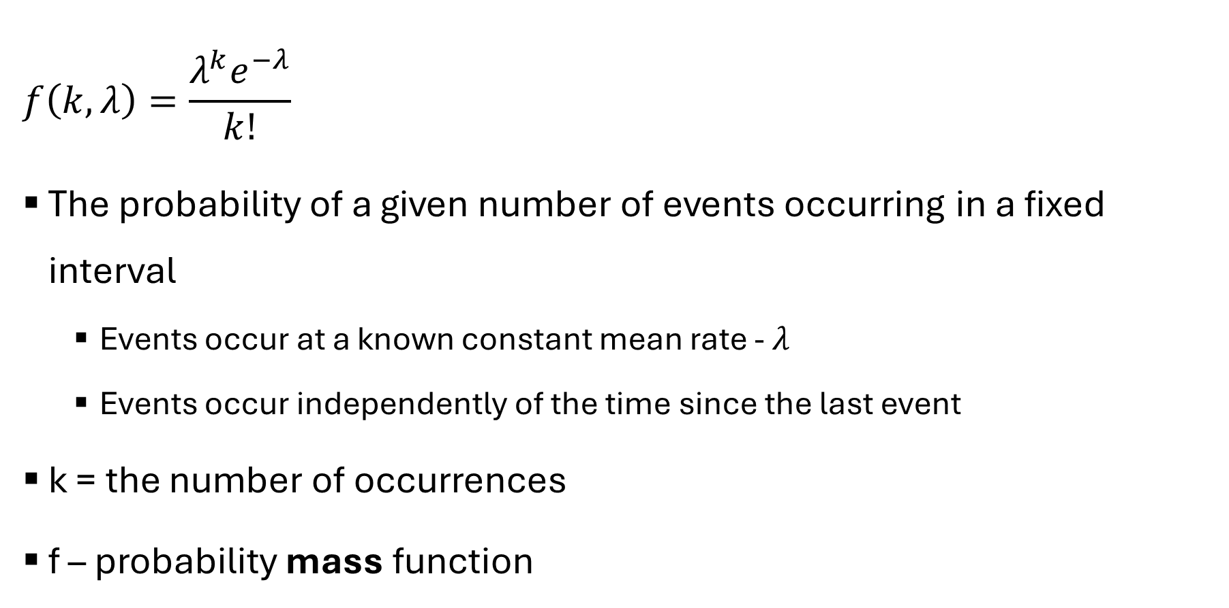
Poisson
$$f\left(k, λ\right)=\frac{λ^{k}e^{−λ}}{k!}$$
The probability of a given number of events occurring in a fixed interval
Events occur at a known constant mean rate - $λ$
Events occur independently of the time since the last event
k = the number of occurrences
f – probability mass function
Notes:
expresses the probability of a given number of events occurring in a fixed interval of time if these events occur with a known constant mean rate and independently of the time since the last event.
For instance, consider a call center which receives an average of λ = 3 calls per minute at all times of day. If the calls are independent, receiving one does not change the probability of when the next one will arrive. Under these assumptions, the number k of calls received during any minute has a Poisson probability distribution.
The fixed time interval is typically specified when describing the rate λ\lambdaλ. For example, if you are modeling the number of cars passing through a toll booth in 1 hour, then λ\lambdaλ would represent the average number of cars passing through the toll booth per hour.

Slide 35
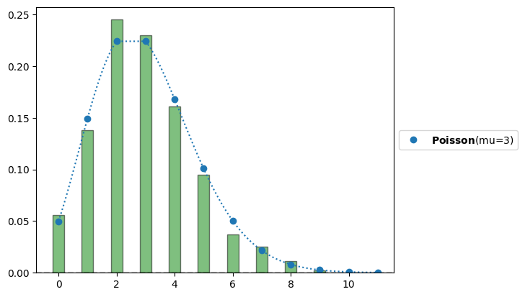
Poisson

Slide 36
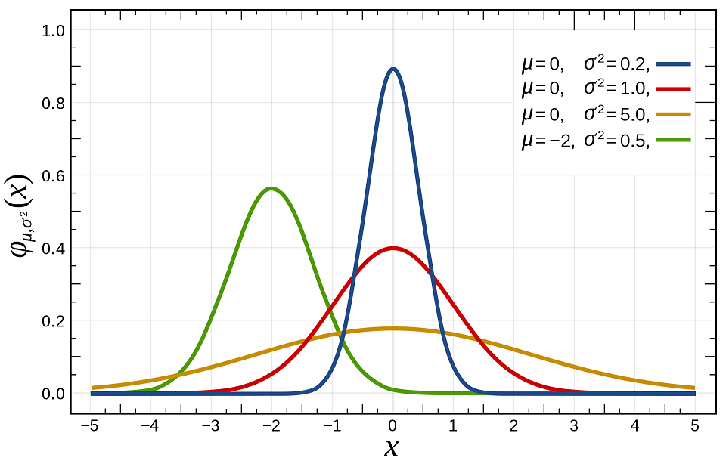
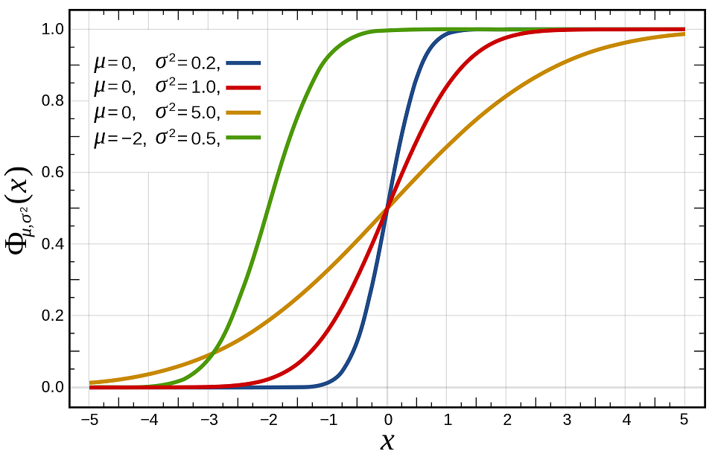


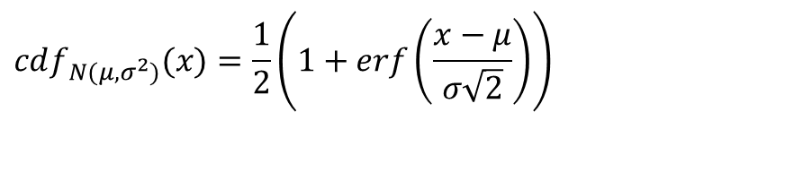
Cumulative Distribution Functions
$P(X≤x)$
$$cdf_{N(μ,σ^{2})}(x)=\frac{1}{2}\left(1+erf\left(\frac{x−μ}{σ\sqrt{2}}\right)\right)$$

Slide 37
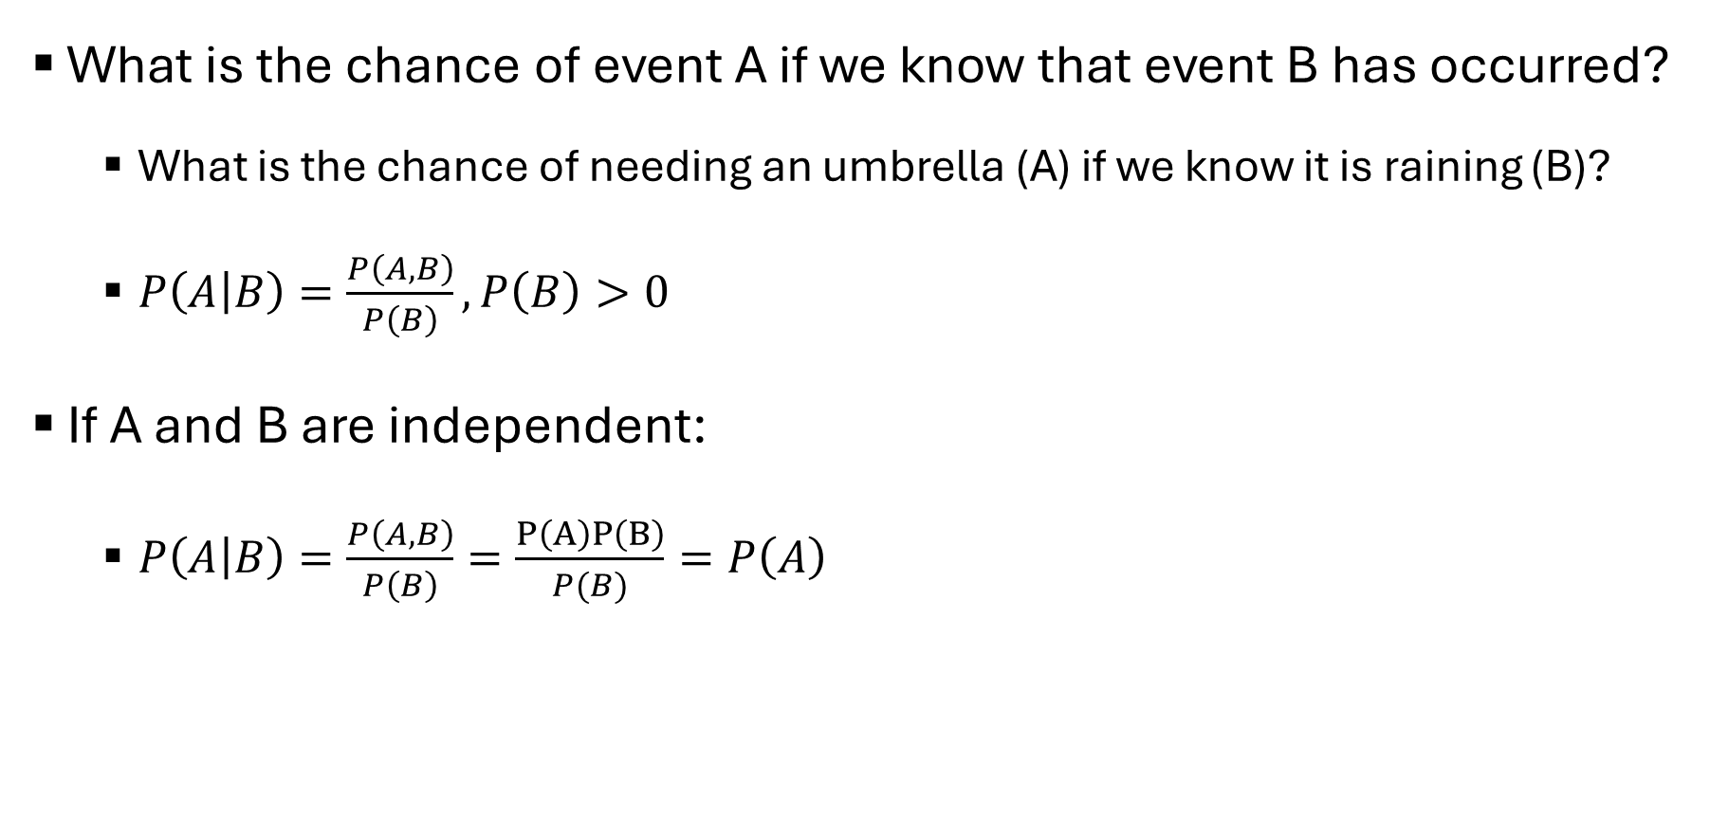
Conditional Probability
What is the chance of event A if we know that event B has occurred?
What is the chance of needing an umbrella (A) if we know it is raining (B)?
$P\left(A | B\right)=\frac{P\left(A, B\right)}{P\left(B\right)}, P\left(B\right)>0$
If A and B are independent:
$P\left(A | B\right)=\frac{P\left(A, B\right)}{P\left(B\right)}=\frac{P\left(A\right)P\left(B\right)}{P(B)}=P\left(A\right)$

Slide 38
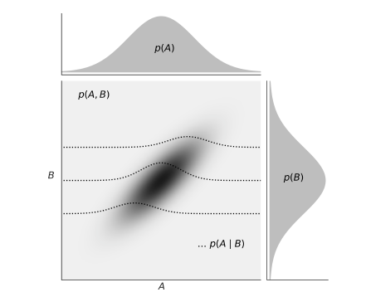

Conditional Probability
Dark colors = higher probability
Higher A $↔$higher B
Dashed lines show P(A|B) for 3 different values of B.
Marginal Distributions: P(A), P(B)

Slide 39

Conditional Probability
Fair dice: what is the probability of rolling 3?
$P\left(3\right)=\frac{1}{6}$
What is the probability of rolling 3 if we know we rolled an odd number?
$P\left(3 | \{1, 3, 5\}\right)=\frac{\frac{1}{6}}{\frac{1}{2}}=\frac{1}{3}$
Notes:
The probability of both rolling a 3 and rolling an odd number is simply the probability of rolling a 3, because 3 is an odd number.

Slide 40
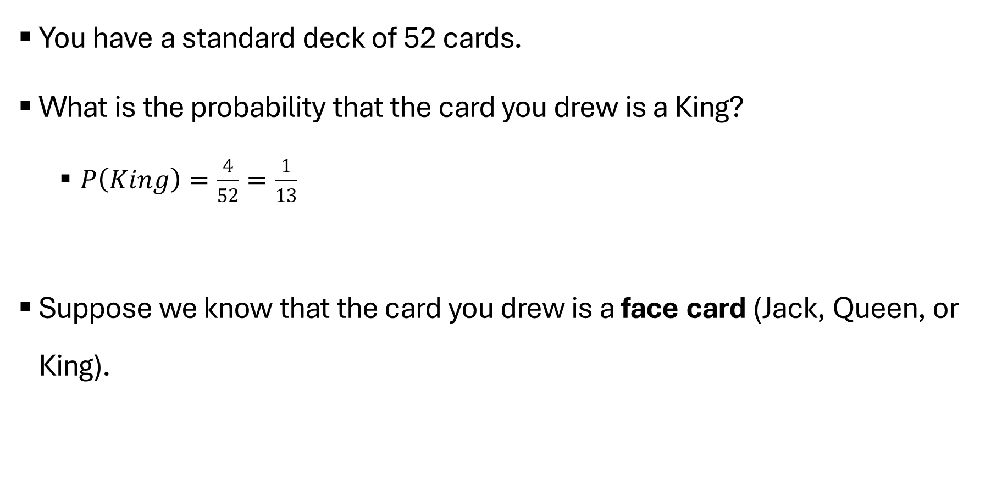
Conditional Probability
You have a standard deck of 52 cards.
What is the probability that the card you drew is a King?
$P\left(King\right)=\frac{4}{52}=\frac{1}{13}$
Suppose we know that the card you drew is a face card (Jack, Queen, or King).

Slide 41
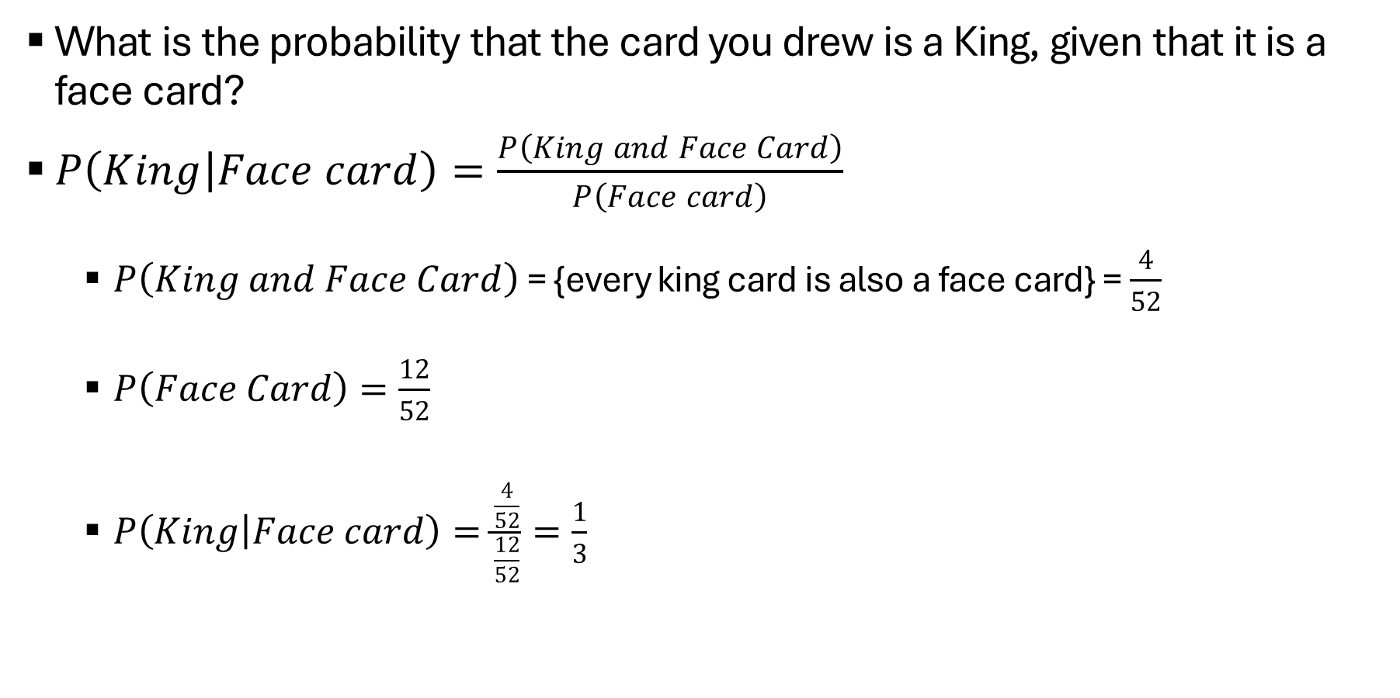
Conditional Probability
What is the probability that the card you drew is a King, given that it is a face card?
$P\left(King | Face card\right)=\frac{P\left(King and Face Card\right)}{P\left(Face card\right)}$
$P\left(King and Face Card\right)$ = {every king card is also a face card} = $\frac{4}{52}$
$P\left(Face Card\right)=\frac{12}{52}$
$P\left(King | Face card\right)=\frac{\frac{4}{52}}{\frac{12}{52}}=\frac{1}{3}$

Slide 42
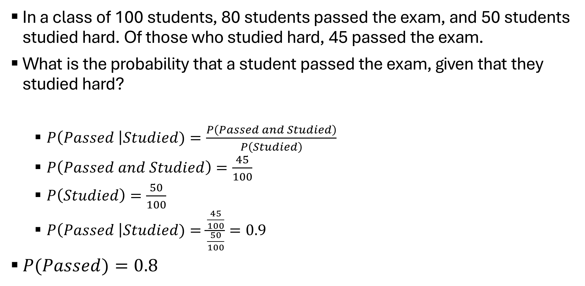
Conditional Probability
In a class of 100 students, 80 students passed the exam, and 50 students studied hard. Of those who studied hard, 45 passed the exam.
What is the probability that a student passed the exam, given that they studied hard?
$P\left(Passed \right|Studied)=\frac{P\left(Passed and Studied\right)}{P\left(Studied\right)}$
$P\left(Passed and Studied\right)=\frac{45}{100}$
$P\left(Studied\right)=\frac{50}{100}$
$P\left(Passed \right|Studied)=\frac{\frac{45}{100}}{\frac{50}{100}}=0.9$
$P(Passed)=0.8$

Slide 43
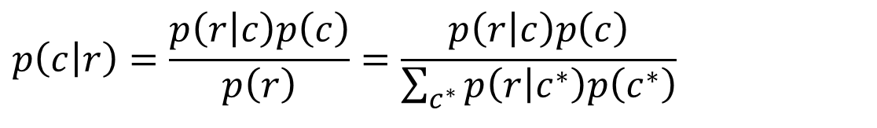
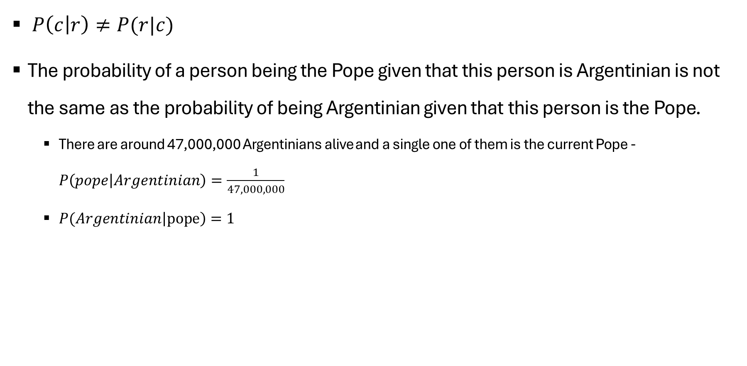
Bayes Theorem
$$p\left(\left.c\right|r\right)=\frac{p\left(\left.r\right|c\right)p\left(c\right)}{p\left(r\right)}=\frac{p\left(\left.r\right|c\right)p\left(c\right)}{\sum_{c^{∗}}{p\left(\left.r\right|c^{∗}\right)p\left(c^{∗}\right)}}$$
$P\left(c | r\right)≠P(r|c)$
The probability of a person being the Pope given that this person is Argentinian is not the same as the probability of being Argentinian given that this person is the Pope.
There are around 47,000,000 Argentinians alive and a single one of them is the current Pope - $P\left(pope | Argentinian\right)=\frac{1}{47,000,000}$
$P(Argentinian\left|pope\right)=1$

Slide 44

Bayes Theorem
$P\left(\left.\text{model}\right|\text{data}\right)=\frac{P\left(\left.\text{data}\right|\text{model}\right)P\left(\text{model}\right)}{\sum_{\text{models}}{P\left(\left.\text{data}\right|\text{model}\right)P\left(\text{model}\right)}}$
Prior distribution: what do we know about the values of the model before seeing the data.
Likelihood: how we will introduce our data.
Posterior distribution: the result of Bayesian analysis -> reflects all we know about our question given our data and model.
Probability distribution for the parameters in our model
Not a single value
Marginal likelihood: probability of observing the data averaged over all the possible values the parameter can take
Normalization factor

Slide 45
Inference Statistics
We collect a sample (data) - finite
We can calculate numerical summaries
Mean
Variance
Skewness
Goal: making statements beyond the current data

Slide 46
Models
Simplified description of a system or process
Capture only the most relevant aspects of the system
Do not explain every minor detail
A more complex model is not always better

Slide 47
A basic approach
Start with data
Make model of data
Combine data with model
To reach conclusions
Evaluate model
Update
Repeat

Slide 48
Models
A model is a specific idea about the shape of the population
A particular distribution
With specific parameters
We can use models to:
Express ideas about the population.
Check ideas about the population.
Provide alternative ideas about the population.
A good model:
Fits the data
Simple
Expressive
Notes:
Fits the data – how do we check. Does it have to be simple to be good? And what does expressive mean?
Model – anything that generates numbers. We can use models to examine how estimators behave. A good model of the population would be those things (in yellow), but a model can be good for other purposes and not answer those criteria.
Show a little example of simulated heights, and then a good model and a bad one. Does it make sense that the data came from this model?

Slide 49
Models
heights = np.array([165, 161, 157, 165, 162, 164, 161, 169, 160, 174, 165, 166, 163, 160, 154, 150, 162, 171,
166, 172, 157, 175, 158, 168, 163, 164, 164, 167, 161, 169, 170, 168, 166, 163, 163, 163,
166, 159, 166, 164, 174, 173, 171, 158, 165, 172, 164, 155, 163, 169, 164, 161, 153, 167,
160, 162, 159, 163, 175, 161, 167, 172, 160, 173, 163, 176, 148, 162, 165, 160, 170, 166,
167, 166, 165, 157, 171, 170, 168, 162, 165, 169, 165, 166, 162, 165, 157, 175, 169, 156,
157, 164, 169, 169, 162, 161, 152, 168, 167, 163])
Notes:
100 heights

Slide 50
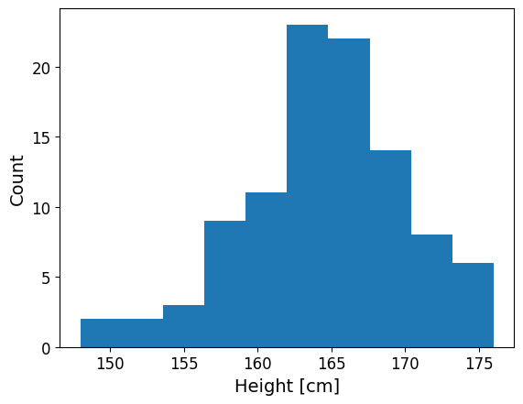
Models
Examine the data

Slide 51

Models
Does it make sense that this data came from each model?
Notes:
If the data was skewed, or had not zero kurtosis – coulnt model using normal distribtion

Slide 52
Models
plt.hist(heights, density = True, bins = 10)
#models pdf_f = stats.norm.pdf(np.linspace(140, 200, 100), np.mean(heights), np.std(heights))
plt.plot(np.linspace(140, 200, 100), pdf_f, color = 'red', lw = 3, label = f'N({round(np.mean(heights), 2)}, {round(np.std(heights), 2)})')
pdf_f2 = stats.norm.pdf(np.linspace(140, 200, 100), np.mean(heights) + 10, np.std(heights)*0.75)
plt.plot(np.linspace(140, 200, 100), pdf_f2, color = 'teal', lw = 3, label = f'N({round(np.mean(heights), 2) + 10}, {round(np.std(heights), 2)*0.75})')
plt.ylabel('Probability', fontsize = 12)
plt.xlabel('Height [cm]', fontsize = 12)
plt.xticks(fontsize=12)
plt.yticks(fontsize=12)
plt.legend(fontsize = 12)

Slide 53

Example Dataset
Self-reported and real weight and height of 200 students – 88 males and 112 females.
Notes:
This is our sample. What could be the population?

Slide 54

Example Dataset
Examine data
Notes:
Weight looks skewed, height has two peaks – cant model using normal distribution

Slide 55

Example Dataset
Examine data
Notes:
Weight doesn’t look so normally distributed, each gender height does -> model

Slide 56

Example Dataset
Compute statistics
Notes:
Use the data (sample) mean and standard deviation to generate a model that hopefully represents the population

Slide 57

Example Dataset
Model data
Notes:
Population, data, model

Slide 58
Probability
Our models will be probabilistic models
Probabilities allow for modeling uncertainty

Slide 59

Probability
Question: how do people feel about the sunny weather where they live?
Experiment: ask 3 people if they like the weather or not (yes/no).
Sample space: all possible outcomes of an experiment
$S=\{\left(y,y,y\right), \left(y,y,n\right), \left(y,n,y\right), \left(n,y,y\right), \left(y,n,n\right), \left(n,y,n\right), \left(n,n,y\right), \left(n,n,n\right)\}$
Events: subset of the sample space
Example: $event A=\left(y,y,y\right)$
$event B=\{\left(y,y,n\right), \left(y,n,y\right), \left(n,y,y\right), \left(y,n,n\right), \left(n,y,n\right), \left(n,n,y\right), \left(n,n,n\right)\}$
Probability of an event: if all events are equally likely:
$P\left(A\right)=\frac{size\left(A\right)}{size\left(S\right)}$
Notes:
Event B – at least one person answered no

Slide 60
Probability
Considering all events equally likely makes calculating probability easier, but it’s not necessarily true.
It is NOT true that all yes-no questions have a 50-50 chance (do you like going to the doctor?)
What is the probability of seeing a purple horse?
Natural color
Cartoon

Slide 61

Random Variable
Function that maps the sample space into real numbers (R)
P(X=3), P(X=x), P(x$≤$4)
Discrete / Continuous
1
2
3
4
5
6
Notes:
The mapping between the sample space and ℝ is deterministic. There is no randomness
involved. So why do we call it a random variable? Because we can ask the variable for
values, and every time we ask, we will get a different number.

Slide 62
Discrete Random Variables + Distributions
Instead of calculating probabilities of events, we may be more interested in finding out the list of probabilities for all possible events = probability distribution
Empirical probability distribution:
roll a dice a bunch of times
count how many times we get each number
Normalize by dividing the value for each number by the number of times the dice was rolled
We will do this using advanced computational methods

Slide 63



BetaBinomial

Slide 64

Continuous (e.g., normal distribution)

Slide 65

Cumulative Distribution Function

Slide 66

Conditional Probability
What is the chance of event A if we know that event B has occurred?
What is the chance of needing an umbrella (A) if we know it is raining (B)?
$P\left(A | B\right)=\frac{P\left(A, B\right)}{P\left(B\right)}, P\left(B\right)>0$
If A and B are independent:
$P\left(A | B\right)=\frac{P\left(A, B\right)}{P\left(B\right)}=\frac{P\left(A\right)P\left(B\right)}{P(B)}=P\left(A\right)$
Fair dice: what is the probability of rolling 3?
$P\left(3\right)=\frac{1}{6}$
What is the probability of rolling 3 if we know we rolled an odd number?
$P\left(3 | \{1, 3, 5\}\right)=\frac{????}{\frac{1}{2}}=\frac{1}{3}$

Slide 67

Conditional Probability
Dark colors = higher probability
Higher A $↔$higher B
Dashed lines show P(A|B) for 3 different values of B.
Marginal Distributions: P(A), P(B)

Slide 68




Bayes Theorem
$$p\left(\left.c\right|r\right)=\frac{p\left(\left.r\right|c\right)p\left(c\right)}{p\left(r\right)}$$
$$=\frac{p\left(\left.r\right|c\right)p\left(c\right)}{\sum_{c^{∗}}{p\left(\left.r\right|c^{∗}\right)p\left(c^{∗}\right)}}$$
$P\left(c | r\right)≠P(r|c)$
The probability of a person being the Pope given that this person is Argentinian
is not the same as the probability of being Argentinian given that this person is the Pope. As
there are around 47,000,000 Argentinians alive and a single one of them is the current Pope,
we have 𝑝 (Pope ∣ Argentinian) ≈ 1
47000000 and we also have 𝑝 (Argentinian ∣ Pope) = 1.
$P\left(\left.\text{model}\right|\text{data}\right)=\frac{P\left(\left.\text{data}\right|\text{model}\right)P\left(\text{model}\right)}{\sum_{\text{models}}{P\left(\left.\text{data}\right|\text{model}\right)P\left(\text{model}\right)}}$

Slide 69

Bayes Theorem
Prior distribution: what do we know about the values of the model (theta) before seeing the data Y.
Likelihood: how we will introduce our data.
Posterior distribution: the result of Bayesian analysis -> reflects all we know about our question given our data and model.
Probability distribution for the parameters in our model
Not a single value
Marginal likelihood: probability of observing the data averaged over all the possible values the parameter can take
Normalization factor

Slide 70
Interpreting Probabilities
What is the probability of a car tire exploding of filled with air beyond the manufacturer’s recommendation?
Frequentist: inflate 100 tires and check.
What is the probability of life on Mars?
We can’t create 100 universes with a Mars and check on each one.
Bayesian statistics: probabilities can be interpreted as measures of one’s uncertainty about events. Probabilities are about our state of knowledge of the world and not necessarily based on repeated trials.

